Slide 1
Station 1: Vocabulary
Directions: Use the word bank for the definitions. Write the correct word on your answer sheet.
Referring to the neck area
A passage used for eliminating fecal, urinary, and reproductive discharges
Examples include a snake’s tongue, iguana tongues have a small, deep pink notch only visible after the iguana has reached a year of age
An animal whose temperature varies with that of its environment, excluding birds and mammals
Used when referring to viviparous, oviparous, and ovoviviparous animals that are pregnant
Absorbs heat by laying/resting/basking in the sun
The lower jaw
8. The development of the yolk in the eggs

Slide 2
9. A behavior that generally includes snakes and lizards, especially those in desert environments
Rock and crevice dweller
11. The opening at the back of the tongue leading into the trachea
12. Loss of muscle coordination
13. The remnant of the hind limb, visible as a small claw on either side of the vent, on boas and pythons. On some tortoises, an enlarged scale projecting out from the legs, generally the inside of the hind legs
14. Increased amounts of, or excessive, yellow, coloring
15. This thermoregulatory behavior is practiced by lizards in well-shaded forests and nocturnal lizards.
16. Term used for reptile “hibernation.”

Slide 3
Word Bank: Not all of the words/terms will be used.
Ataxia Estivation Mandible Ovoviviparous Spur
Bifurcated Folliciles Maxilla Parathyroid Thermoregulate
Carbuncle Follicular Vitellogenesis Nephrotoxic Pipping
Thigmothermic Hepatic Scotophase Xanthic Torpor
Cloaca Glottis Nuchal Poikilotherm Crepuscular
Dysecdysis Gravid Oviparous Saxicolous Vivparous
Dystocia oviposition Brumation Heliothermy

Slide 4
Station 2: Facts
True/False: Carolus Linnaeus distinguished clearly amphibians from reptiles.
2. True/False: Amphibians and reptiles have received the least attention in terms of conservation efforts
In Endotherms, heat production must be balanced with ______________
4. Why is the cost of endothermy prohibitively higher for animals with small masses?
5. How would endothermy affect the functionality of enzymes?
6. Comparatively, how much energy do endotherms convert into production? Ectotherms? Please give answers as a range of values.

Slide 5
7. Which of the following is not an advantage of ectothermy? (choose all that apply)
A. Permits survival in harsh environment
B. Permits ectotherms to function in ecosystems almost as producers of energy, rather than consumers
C. the high levels of sustained activity may increase growth rates and reproductive output
D. permits large body mass
E. permits greater morphological plasticity
F. diverse shapes allow diverse roles and behaviors
8. Approximately how many snake species world-wide are venomous, and how many of those are considered harmful to humans?
9. Why do snakes and lizards flick their tongues? Include the specific organ used in your answer.
What protein are the scales of snakes and many lizard species made up of?
11. What biological process/strategy/adaptation do many female snakes use during their pregnancy or immediately after “birth”?

Slide 6
Station 3: Reproduction
Anuran reproduction is strongly associated with _______________
____________ is the main constraint on mating success for Anurans
3. For crocodiles, eggs may be deposited in all of the following ways except for
a. in hollow locations, such as a tree trunk
b. on mounds of vegetation and other detritus near shorelines
c. burrows in sand
d. on floating vegetation mats in shallow water
Directions for questions 4 - 10Match the following characteristics of eggs as belonging to either snakes, turtles, or both
4. leathery or rubbery to the touch
5. feel like a bag of jelly or liquid
6. increase greatly in size over the course of incubation
7. slightly oblong, white to cream in color
8. cannot draw water from the environment
9. deposited in an already sheltered spot
10. rigid shells that don’t open very wide
11. Bufonidae reproductive modes are diverse- most with _____(aquatic or terrestrial or both)___________ larvae, but some __________________ or _____________________.

Slide 7
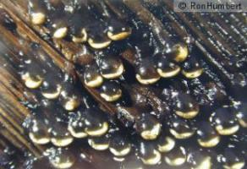
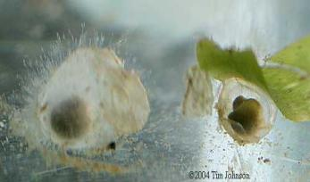
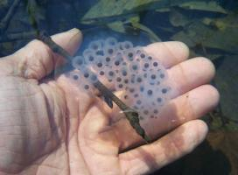
12. In Salamanders, the anterior teeth of males of some species of Plethodontids are used to ______________ and inoculate her with ________________ released from the mental gland
13. In most cases, salamanders that breed in water, lay eggs _______________
Directions for questions 14 to 16: Identify the family to which the eggs belong.
14.
15.
16.

Slide 8
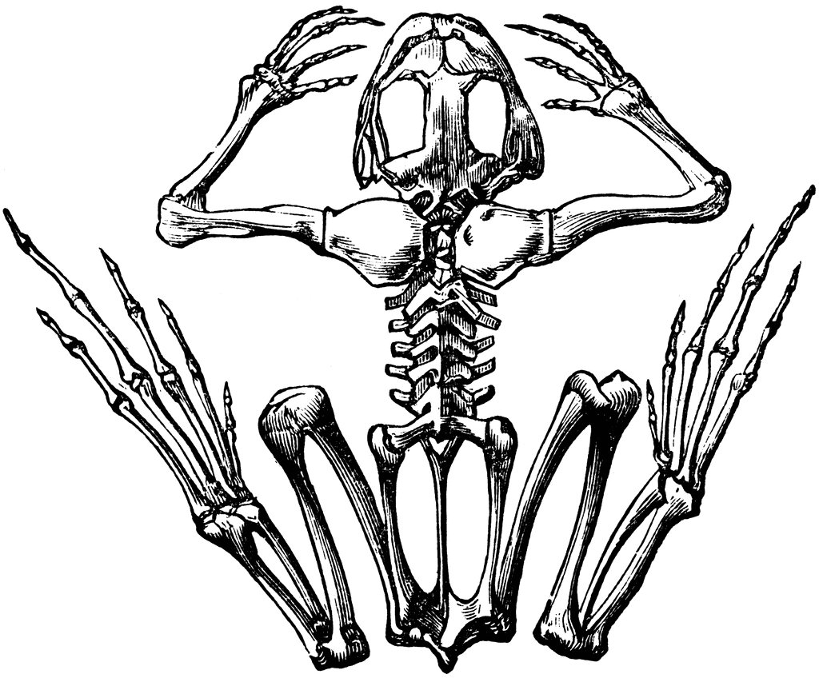
Station 4: Amphibians I
1.
2.
3.
4.
5.
6.
7.
8. What family of Anura is found worldwide, except for Antarctica?

Slide 9
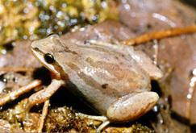
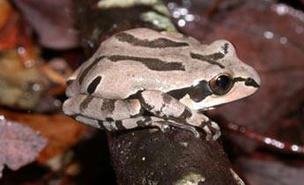
Sounds?
9. Name the family and genus of this organism.
What is the diet of the adult of this genus?
11. Where in North America can this genus be found?

Slide 10
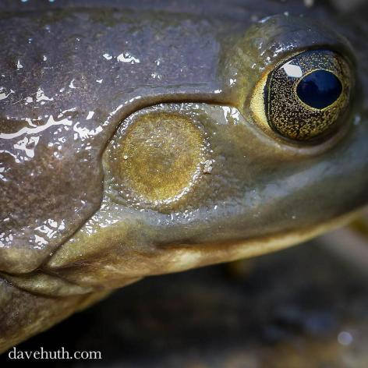
12. What feature is shown here?
13. What is the purpose of the feature?
14. Where does this feature work, on land, in the water, or both?
15. The circumference of this feature is slightly smaller than the size of the eye. What gender is this specimen likely to be?

Slide 11
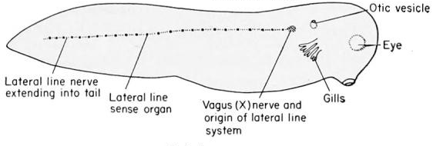
The accompanying picture is of a tadpole.
Identify A
17. Identify B
18. Identify C
19. Identify D
A
B
D
C
20. Select which of the following (more than one) applies to Family Ranidae.
No Teeth
Teeth in upper jaw
Poison gland behind each eye
Long powerful legs for jumping
Shorter legs for walking
Eggs laid in long chains
Eggs laid in clusters
Eyes bulge from body
Lives in water

Slide 12
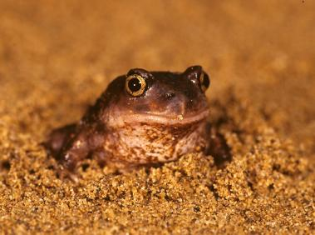
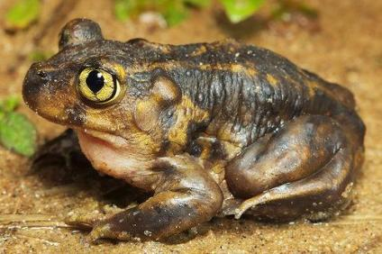
21. Identify the Family and Genus of the above shown organisms.
Describe the preferred habitat for this organism.
How long does it take this genus’s eggs to hatch?
What term is used to describe this organism’s behavior during dry periods?

Slide 13
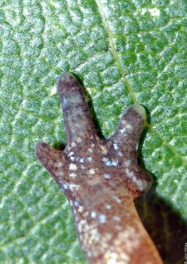
Station 5: Amphibians I I
What area/region of the United States has the greatest salamander diversity?
2. A rare field observation that can be used to identify the genus for this organism. What is the genus?
3. Which limb would the feature be found on?
What 2 external characteristics would be more likely to be observed in the field?
5. What family does this organism belong to?
What unique characteristic makes them good bio-indicators?
7. What is the primary threat to this organism?

Slide 14
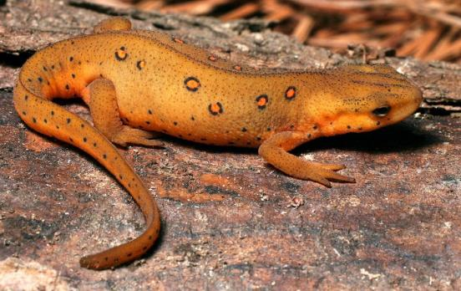
8. Identify the class, order, and family of the animal pictured. (3 points)
9. What two distinguishing features are characteristic in this family from other members of the order? (2 points)
10. How many toes are on their fore limbs?
11. How many toes are generally on their hind limbs?
12. How genera of this family are endemic to the North American continent?
13. This family tends to have bright coloration which serves as a warning for what danger?

Slide 15
14. Select the true statements
Fertilization is external.
Most species have well developed lungs
This organism breathes through the skin as a primary source of oxygen.
The female of the species cares for the young for a period of about 1 week.
Lateral line organs augments vision to detect prey.
All larvae are aquatic.

Slide 16
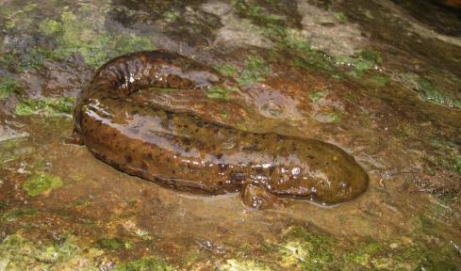
15. What is the family represented on this slide?
This organism is extremely sensitive to its environment. List 4 characteristics of water quality that could harm this organism.
The deeply wrinkled skin of the above organism serves as an adaptation for what necessary biological need?
18. Why is cool, fast moving water essential for the survival of this organism?

Slide 17
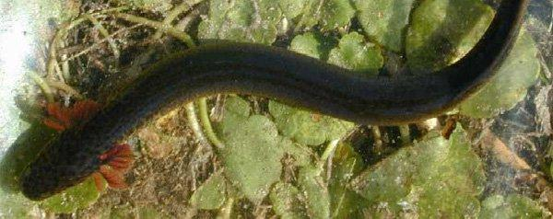
Identify the correct family for this organism.
20. Identify the circled physical feature.
21. What is the circled feature used for biologically?
22. Name a unique feature of this organism’s limbs.
23. What mechanism allows this organism to survive desiccation?

Slide 18
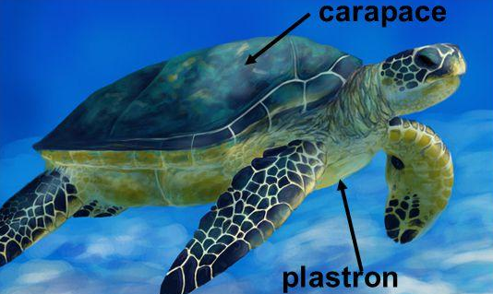
Station 6: Reptiles I
A
Label A
2. Label B
3. What family is shown?
What is the unique feature of this Family’s head in this family?
What part of this organism’s life is spend on land?
B

Slide 19
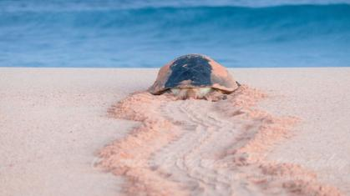
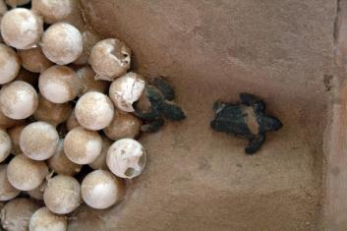
9. A sea turtle nest was found to be 0.5 degrees Celsius higher than the idea. What is a likely result of the slightly higher temperature?
Lack of oxygen and poor muscle development of the hatchlings
Greater ratio of females than males
An exact ratio of one male to one female of the hatchlings
Shorter incubation time resulting in an early hatching during a non-full moon
What act did this turtle just complete?
What is the conservation status of the organisms in this Family?
What is the gender of this organism?

Slide 20
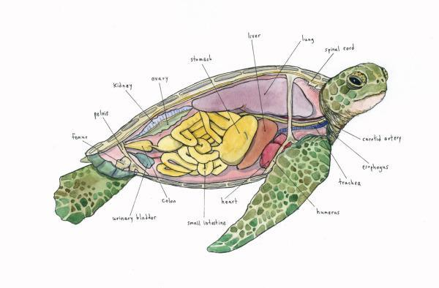
B
C
c
c
A
D
10. Identify the structure representing the lungs.
11. Why are the lungs enlarged in this Family?
12. How does a member of this Family adjust body functions to allow for a long underwater dive?

Slide 21
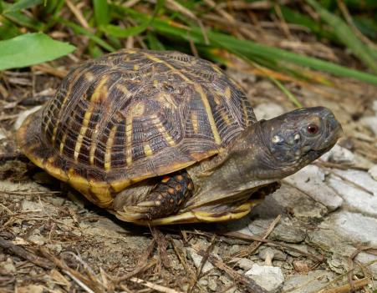
13. Identify the genus of this organism.
14. What type of a diet does this organism need, carnivorous, omnivorous, or herbivorous?
15. Which sex is larger, male or female?
16. Which sex travels longer distances for reproductive purposes?

Slide 22
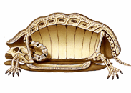
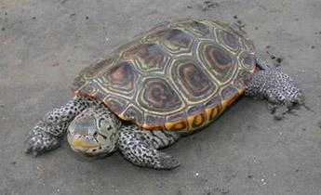
18
19
17
17. Label this part.
18. Label this part.
19. Label this part.
20. What genus is pictured here?
21. What is this genus’s habitat?
22. What months does this genus nest?

Slide 23
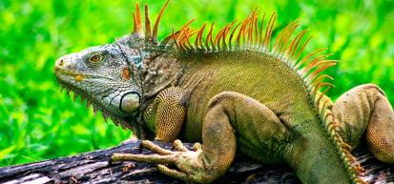
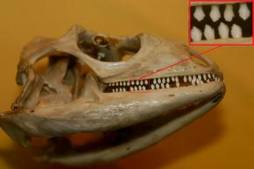
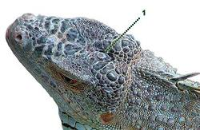
Station 7: Reptiles II
A
What Genus is shown in the first picture?
2. Based on this Genus’s teeth, what is the diet?
3. hat is structure A (in the third picture)?
4. What is the function of structure A?

Slide 24
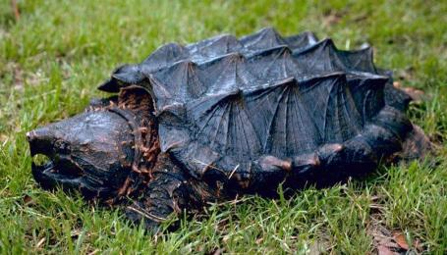
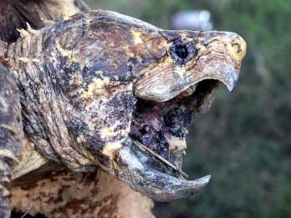
5. Identify this Family.
6. What is unique about this Family’s head retraction?
7. What is this Family’s habitat?
8. In this Family, which are larger, males or females?

Slide 25
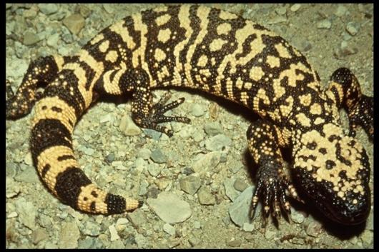
What Family is pictured above?
What is the habitat of this organism?
Which of the jaws contain venom?
12. What is the purpose of the venom in Helodermatidae?

Slide 26
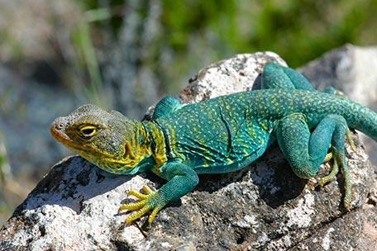
13. What Family is shown in the accompanying picture?
14. What is the habitat of this Family?
15. What is the diet of this family?

Slide 27
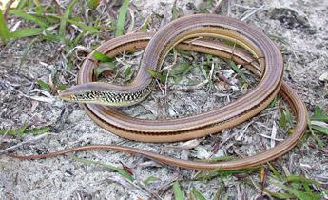
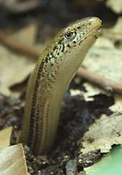
16. What is the Family & Genus of this organism?
17. Is this genus active during day or night?
18. List a significant characteristic of the jaw that distinguishes this genus.
19. What is a significant characteristic of this genus that allows it to escape predation?
20. What two (2 points) feature on the head distinguishes this genus from its look-alike?

Slide 28
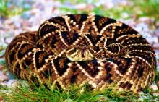
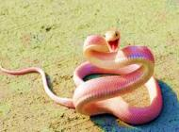
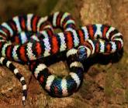
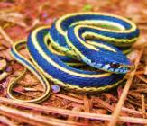
Station 8: Reptiles III
1. Identify the garter snake (Thamnophis) from these images.
A
B
C
D
List two prey items for the garter snake.
What distinctive action do garter snakes do when threatened?
Snakes in colder regions tend to den together, often in mass for the winter. What biological necessity of a den location for snakes causes this behavior?
How does this genus of snakes bear young?
How many garter snakes are typically in a litter?
Why do garter snakes have such large litters?

Slide 29
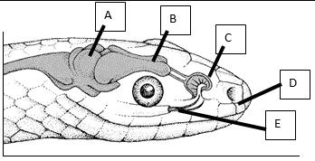
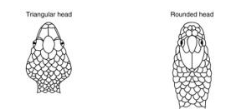
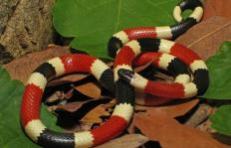
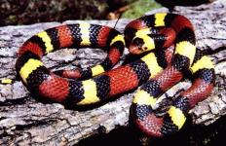
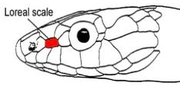
8. Identify which snake is likely venomous, the triangular head or the rounded head.
9. Which of the following is a coral snake (Elipidae)?
6. Which anatomical feature is Jacobson’s organ? (Choose a, b, c, d, or e from above picture.)
7. What is the purpose of Jacobson’s organ?
It allows the snake to smell with its tongue.
It processes visual stimuli without the brain.
It processes smells without the use of the brain.
It protects part of the brain.
It is vestigial in snakes and serves no purpose.
A
B
10 What is the name of the red scale?

Slide 30
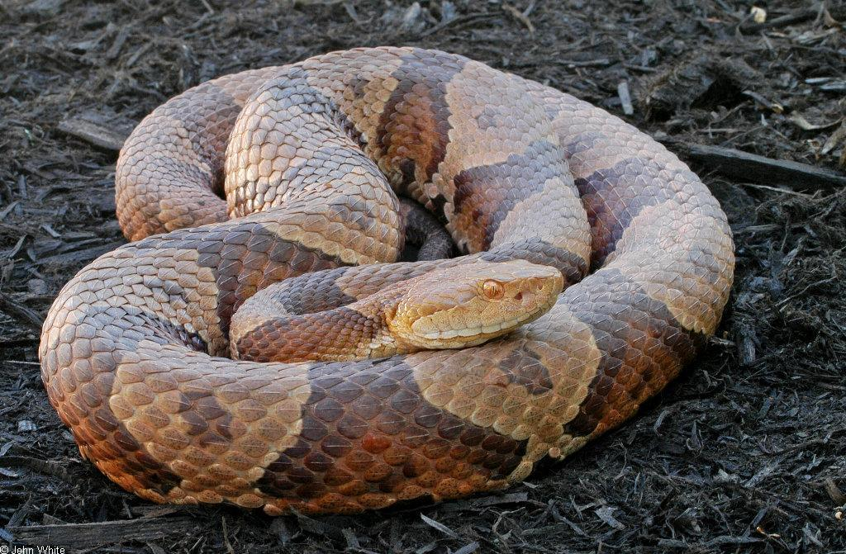
14
15
11. Identify the Family & Genus of this organism.
12. How does this genus reproduce?
13. Select which of the following characteristics are correct about this genus.
A. Venous
B. Long fangs
C. Broad head
D. Narrow head
E. Vertically elliptical pupil
Questions 14 & 15: Label the part indicated.
14.
15.
16. What is the preferred habitat of this organism?

Slide 31
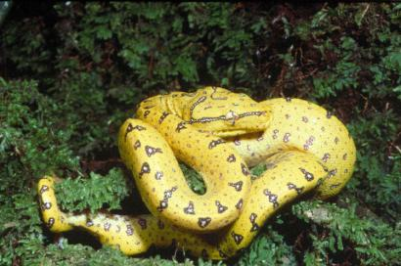
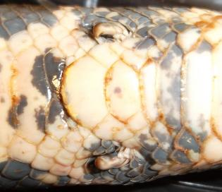
17. Identify the family of this organism.
18. What hunting strategy does this organism use to kill prey?
19. What vestigial structure is pictured on the right?
20. What is the difference between head and body scales on a snake?

